Slide 1
Data Descriptors
What do we mean by average?
What do we mean by dispersion?
What do we mean by shape?
Although tables, diagrams and graphs provide easy to assimilate summaries of data they only go part way in describing data. Often a concise numerical description is preferable which enables us to interpret the significance of the data. In this presentation we will explore answers to these questions and discuss:
Measures of central tendency (or location or average)
Measures of dispersion (or spread or dispersion).
Measures of shape (skewness and kurtosis)

Slide 2
Learning Objectives
On successful completion of the module, you will be able to:
Identify an appropriate average:
    Mean
    Mode
    Median
Identify an appropriate measure of dispersion:
    Range
    Quartile range and Semi-interquartile range
    Variance and Standard deviation
Understand the idea of distribution shape: symmetry and peakedness.
Apply exploratory data analysis to a data set
Use Excel and SPSS to calculate the data descriptor statistics.

Slide 3
Summary of Data Descriptors
Data Descriptors
Central Tendency
Arithmetic Mean
Dispersion or Variation
Shape
Median
Mode
Range
Semi Interquartile Range
Variance
Standard Deviation
Coefficient of variation (see text)
Skewness
Kurtosis

Slide 4
Data Example: Set of Numbers
Suppose the marks obtained in the statistics examination were
We can use Excel to calculate appropriate data descriptors for the ‘raw ‘ data presented in the table. The data descriptors to be calculated are as follows:
Measure of central tendency: mean, median, mode
Measure of dispersion: quartile range, variance, standard deviation
Measures of shape: skewness, kurtosis
24 | 27 | 36 | 48 | 52 | 52 | 53 | 53 | 59 | 60 | 85 | 90 | 95
Please refer online Want to Learn More for examples on how to calculate measures for data in group frequency distributions form.

Slide 5
Central Tendency - Definitions
Mean – Sum all values divided by the number of value. Most popular measure of average.
Median – Is the middle value of an ordered list of values.
Mode - Is the one that occurs most frequently.
Other terms that we will explore include percentiles and quartiles.
These terms will be employed when discussing the concept of dispersion

Slide 6

Mean
24 | 27 | 36 | 48 | 52 | 52 | 53 | 53 | 59 | 60 | 85 | 90 | 95
The mean (or average or arithmetic mean) can be calculated using equation (2.1):
$$\overline{X}= \frac{\sum{X}}{N}= \frac{24+27+ …. +95}{13}= \frac{734}{13}=56.4615$$
  Mean mark is 56.4%
It is important to note that the mean uses all the data values in the data set to provide the average value. For this reason the mean can be affected by any extreme values (outliers). If extreme values exist then an alternative measure of average is the median.

Slide 7
Median
The median is defined as the middle number when the data is arranged in order of size.
24 | 27 | 36 | 48 | 52 | 52 | 53 | 53 | 59 | 60 | 85 | 90 | 95
In Example 2.1, we have a data set that consists of 13 numbers (N=13). Before we calculate the median we make sure that the data values are written in order of size. For the median we want the middle number or the 50th percentile (P = 50). The position of the median can be calculated using equation (2.2) as follows:
Position of median = 7th number.
From the ordered list we see that the 7th number corresponds to the number 53.
Median mark = 53%

Slide 8
Mode
The mode is defined as the number which occurs most frequently (the most ‘popular’ number).
24 | 27 | 36 | 48 | 52 | 52 | 53 | 53 | 59 | 60 | 85 | 90 | 95
From Example 2.1. we observe that the numbers 52 and 53 both occur twice:
mode = 52 and 53
In other words, we have two modal values for this example and in general we do not tend to use the mode to provide an average for data involving numbers.
Where it is useful is when you are attempting to provide a average measure for categorical data e.g. what is the most popular chocolate bar.

Slide 9
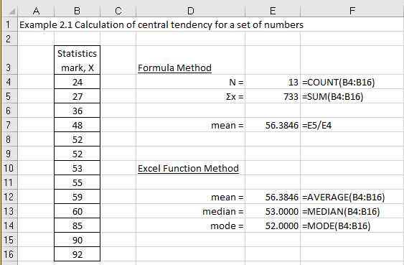
Excel solution
Example 2.1
Excel solution to calculate mean, median, and mode.
Note. The Excel and SPSS solutions provide only one value for the mode (lowest value).

Slide 10
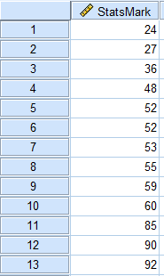
SPSS solutions
Using the Examples 2.1 data, we can extract the same statistics from SPSS in the following manner. The SPSS file that contains the data is given in Chapter 2_Statsmark.sav and the variable is called StatsMark.
With SPSS we have three methods to calculate descriptive statistics:
Frequencies.
Descriptives.
Explore.
Let us look at the Frequencies and Explore methods.

Slide 11
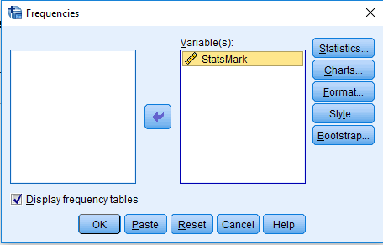
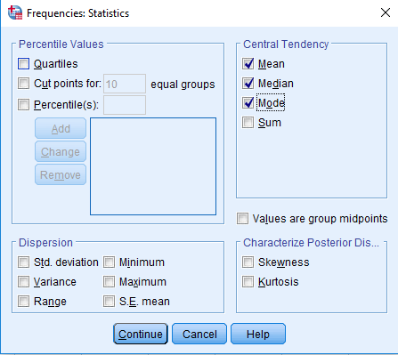
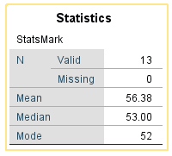
SPSS Method 1 Frequencies method
Select Analyze > Descriptive Statistics > Frequencies. Transfer StatsMark to the Variable(s) box
Click on Statistics
Under Central Tendency choose Mean, Median, and Mode.
SPSS output
Click Continue. Click OK

Slide 12
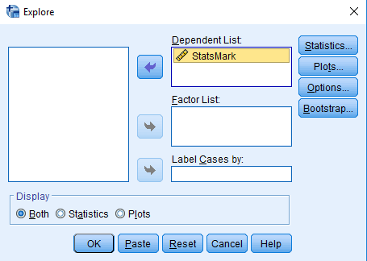
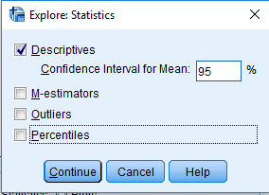
SPSS Method 3 Explore method
Select Analyze > Descriptives > Explore
Transfer variable StatsMark to the Variable(s) box
Click on Statistics and choose Descriptives
Click Continue
Click OK

Slide 13
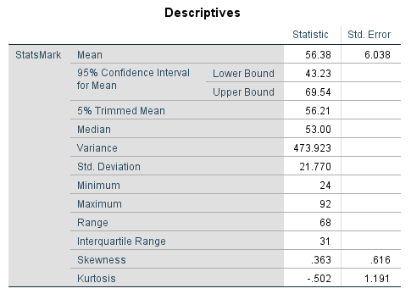
SPSS Method 3 Explore method continued
SPSS output
This provides a range of descriptive statistics

Slide 14
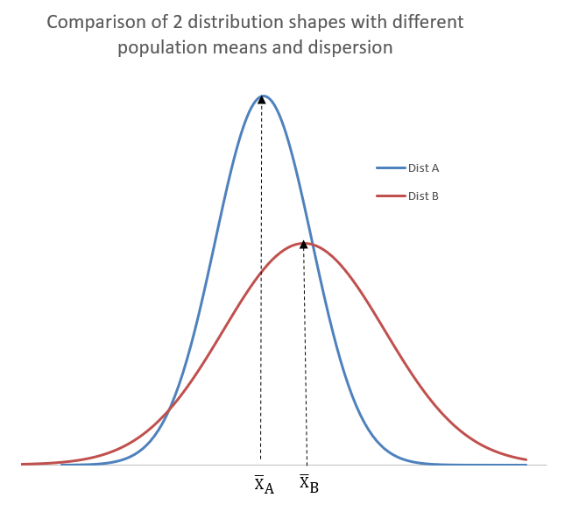
Dispersion (or spread or variation)
The two most commonly used measures of dispersion are: standard deviation and semi interquartile range.
Let us say the means of the two distributions, A and B, were 4000 and 5000 respectively.
As you can see their shapes are very different, with B being far more spread out compared to distribution A.
We now need to provide a measure for the degree of spread (or dispersion) within the data set: range, variance, standard deviation, quartile range, and interquartile range.

Slide 15
Measures of Dispersion - Definitions
Range – difference between smallest and largest value.
Variance - measure of the average squared deviations of data values about the mean.
Standard deviation - most popular measure of dispersion (standard deviation is simply the square root of the variance)
Interquartile range – distance between the third and first quartile (middle 50% of distribution).
Semi-interquartile range – half the distance between the third and first quartile

Slide 16
Percentiles and Quartiles
The median is defined as the middle number which corresponds to the 50th percentile for a list of ordered numbers. A percentile is the value of a variable below which a certain percent of observations fall e.g. the 40th percentile is the value below which 40 percent of the observations may be found.
Quartiles tell us that the data set is split into 4 parts with each part having an equal number of values.
For and data sets we have 3 quartiles: (i) first quartile Q₁, (ii) second quartile, Q₂, and (iii) third quartile, Q₃.
25%
25%
25%
25%
Q₁
Q₂
Q₃

Slide 17
Percentiles and Quartiles continued
Example 2.2
First Quartile, Q₁
The first quartile corresponds to the 25th percentile and the position of this value within the ordered data set is given by equation (2.2):
We therefore take the 25th percentile to be the number that is half the distance between the 4th and 3rd numbers. To solve this problem, we use linear interpolation between the two nearest ranks:
Position of 25th Percentile = 3rd number + 0.5*(4th number – 3rd number).
From the list of ordered data values, the 3rd number = 36 and 4th number = 48.

Slide 18
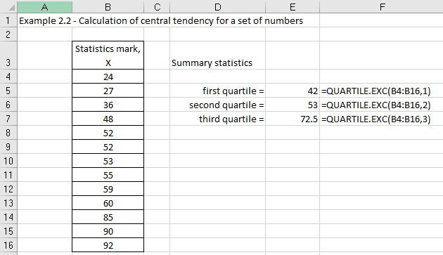
Excel solution
From Excel:
First quartile
Q₁ = 42
Second quartile (or median)
Q₂ = 53
Third quartile
Q₃ = 72.5

Slide 19
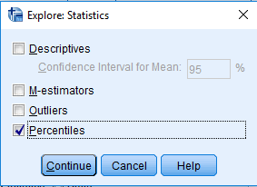
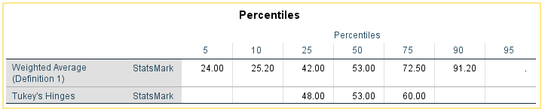
SPSS solution
Using the Explore method
Select Analyze > Descriptives > Explore
Click on Statistics and choose Percentiles
SPSS output
Q₁ = 42
Q₂ = 53
Q₃ = 72.5

Slide 20

Variance and Standard Deviation
The variance represents the squared deviations of each data value from the mean value
X | X²
24 | 576
27 | 729
36 | 1296
48 | 2304
52 | 2704
52 | 2704
53 | 2809
55 | 2809
59 | 3481
60 | 3600
85 | 7225
90 | 8100
92 | 9025
ΣX = 734 | ΣX² = 47362
$$Variance= \frac{\sum{{\left(X −\overline{X}\right)}^{2}}}{N}$$
Variance = 455.3254…. %²
The standard deviation is the square root of variance
Standard deviation = 21.3%
It should be noted that the units for the standard deviation are the same as the mean and data values. Given that we are using all the data values then both the mean and standard deviation are influenced by the presence of outliers.

Slide 21
Range
This is the simplest definition of a measure of dispersion.
Simply defined as the difference between the largest and smallest value.
  Range = X_{L} – X_{S} = 96 – 24 = 71 marks
Since it only considers the largest and smallest data values it is considered to be a poor measure of dispersion.

Slide 22
Interquartile Range (IQR)
The IQR represents the difference between the 3rd and 1st quartiles:
  QR = Q₃ – Q₁.
The semi interquartile range (SIQR) is defined as half of the QR difference:
  SIQR = (Q₃ – Q₁)/2.
If the data distribution is symmetric then the median ± one semi interquartile will contain 1/2 of the scores.
We should observe that for data sets with a small number of outliers these measures of dispersion will not be affected by the presence of these outlier values.

Slide 23
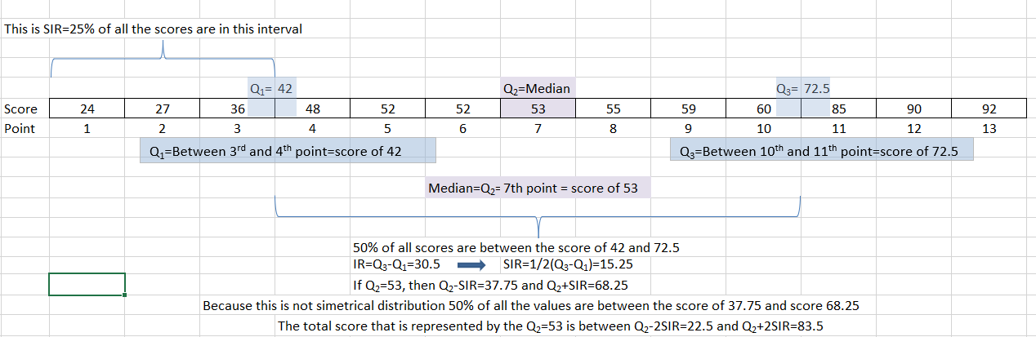
Interquartile Range (IQR) continued

Slide 24
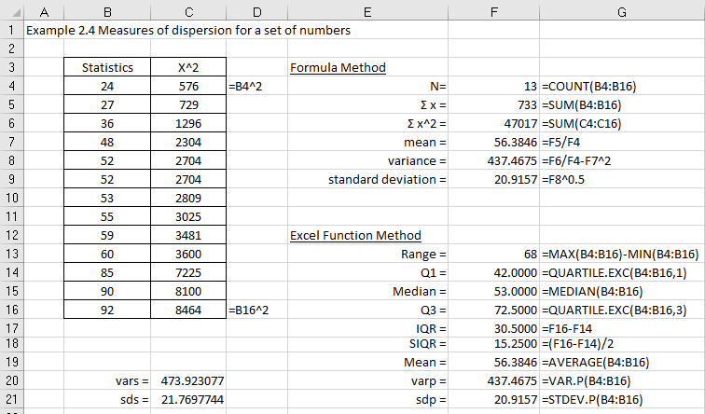
Excel solution
Mean = 56.38
Treating data values X has the entire population
Pop’ variance = 437.47
Pop’ sd = 20.92
If you treat your x values as a sample, then sample variance = 473.92 and sample sd = 21.77. SPSS only provides the sample values.

Slide 25
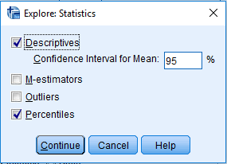
SPSS solution
Select Analyze > Descriptives > Explore
Click on Statistics and choose Descriptives and Percentiles

Slide 26
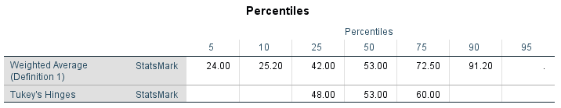
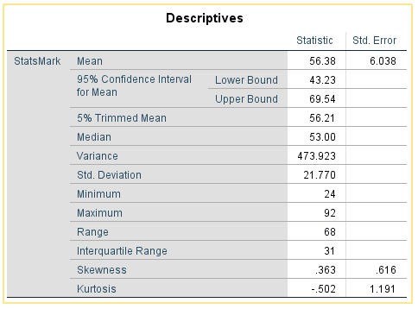
SPSS solution continued
SPSS outputs
From SPSS:
Sample mean = 56.38
Sample variance, sd² = 473.923
Sample standard deviation, sd = 21.770
These agree with the Excel sample solutions in Cells C20 and C21.

Slide 27
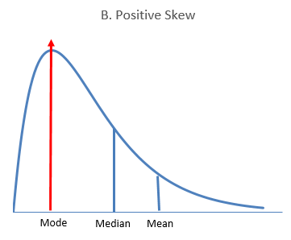
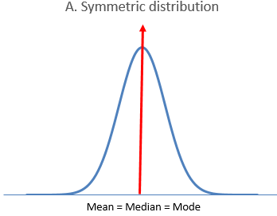
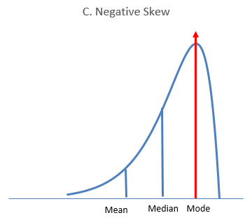
Measures of shape
A fundamental task in many statistical analyses is to characterize the location and variability of a data set.
A further characterization of the data includes the idea of skewness and kurtosis.

Slide 28

Skewness
Fisher’s measure of skewness is a measure of the degree of asymmetry of a distribution.
Sample skewness = 0.0018
If skewness is less than −1, or greater than +1, the distribution is highly skewed.
If skewness is between −1 and −0.5, or between +0.5 and +1, the distribution is moderately skewed.
If skewness is between −0.5 and +0.5, the distribution is approximately symmetric.

Slide 29
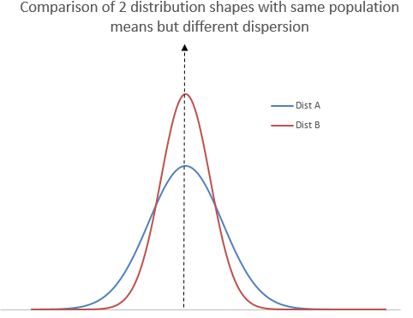

Kurtosis
Fisher’s measure of kurtosis is a measure of whether the data are peaked or flat relative to a normal distribution.
Sample kurtosis = - 0.2686

Slide 30
Kurtosis continued
A normal distribution has kurtosis exactly 3 (excess kurtosis exactly 0). Any distribution with kurtosis ≈ 3 (excess ≈ 0) is called mesokurtic.
A distribution with kurtosis < 3 (excess kurtosis < 0) is called platykurtic. Compared to a normal distribution, its tails are shorter and thinner, and often its central peak is lower and broader.
A distribution with kurtosis > 3 (excess kurtosis > 0) is called leptokurtic. Compared to a normal distribution, its tails are longer and fatter, and often its central peak is higher and sharper.

Slide 31
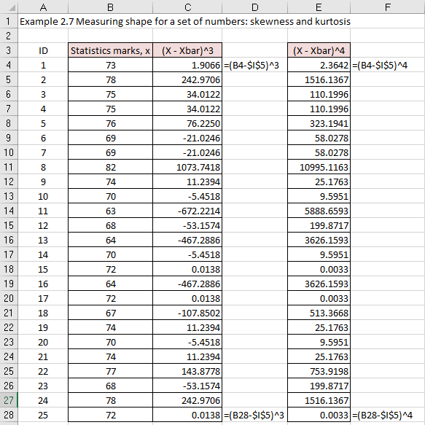
Excel solution

Slide 32
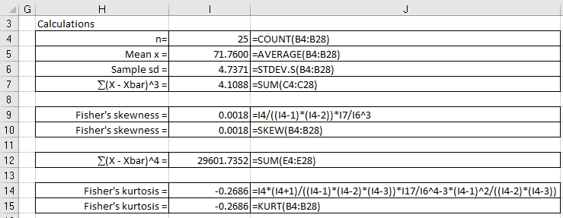
Excel solution continued

Slide 33
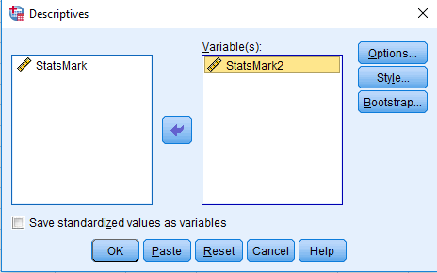
SPSS solution
With SPSS we have three methods to calculate descriptive statistics:
Frequencies.
Descriptives.
Explore.
To illustrate let us choose method 2 (Descriptives) to calculate the value of skewness.
From the SPSS Statistics menu bar, Select Analyze > Descriptives > Descriptives
Transfer variable StatsMark2 to the Variable(s) box

Slide 34
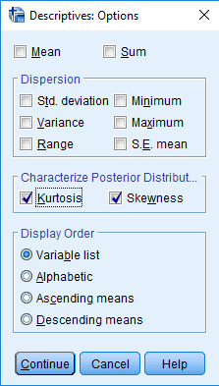
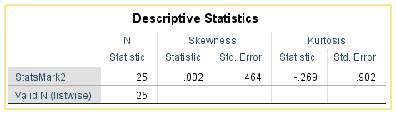
SPSS solution continued
Click on Options and choose Skewness and Kurtosis
SPSS output
Skewness value = 0.002
Kurtosis value = - 0.269
Click on Continue
Click on OK

Slide 35


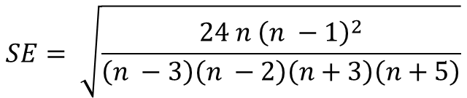
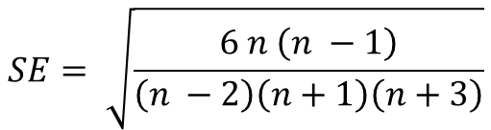
Inference
Since the skewness and kurtosis of the normal distribution are zero, values for these two parameters should be close to zero for data to follow a normal distribution.
If the absolute value of the skewness for the data is more than twice the standard error this indicates that the data are not symmetric, and therefore not normal. Similarly if the absolute value of the kurtosis for the data is more than twice the standard error this is also an indication that the data are not normal.
Skewness
Kurtosis
$$Z= \frac{skewness value}{SE}$$
$$Z= \frac{kurtosis value}{SE}$$
$$SE= \sqrt{\frac{6 n \left(n −1\right)}{\left(n −2\right)\left(n+1\right)\left(n+3\right)}}$$
$$SE= \sqrt{\frac{24 n {\left(n −1\right)}^{2}}{\left(n −3\right)\left(n −2\right)\left(n+3\right)\left(n+5\right)}}$$

Slide 36
Inference continued
Given n = 25
Skewness:
Skewness = 0.002
SE = 0.464
Z = skewness/SE = 0.004
Kurtosis:
Kurtosis = - 0.269
SE = 0.902
Z = kurtosis/SE = - 0.298
For a 95% confidence, Z = -1.96 to + 1.96
Both statistics are within two standard errors, which suggest that the data is likely to be relatively normally distributed. If both values were less than – 1.96 or greater than + 1.96 this would indicate that the data are not normal.

Slide 37
Exploratory Data Analysis (EDA)
Exploratory data analysis consists of using your data set to compute a five number summary and represent these numbers in graphical form (box plots).
For symmetrical distributions, the following rule would hold:
Q₃ - Median = Median - Q₁
Largest value - Q₃ = Q₁ - smallest value
For non-symmetrical distributions, the following rule would hold:
Right-skewed distributions: Largest value - Q₃ greatly exceeds Q₁ – Smallest value
Left-skewed distributions: Q₁ – Smallest value greatly exceeds Largest value - Q₃

Slide 38
EDA continued
Example 2.8
73 | 73 | 73 | 73 | 73 | 73 | 73 | 73 | 73 | 73
78 | 78 | 78 | 78 | 78 | 78 | 78 | 78 | 78 | 78
75 | 75 | 75 | 75 | 75 | 75 | 75 | 75 | 75 | 75
75 | 75 | 75 | 75 | 75 | 75 | 75 | 75 | 75 | 75
The five number summary is:
Smallest value, minimum = 61
First quartile, Q₁ = 66
Median or second quartile, Q₂ = 70
Third quartile, Q₃ = 74
Largest value, maximum = 82

Slide 39
EDA continued
To identify symmetry
Using the numbers we conclude:
The distance from Q₃ to the median (74 – 70 = 4) is the same as between Q₁ and the median (70 - 66 = 4).
The distance from Q₃ and the largest value (82 – 74 = 8) is not the same as the distance between Q₁ and the smallest value (66 – 61 = 4).
These summary values indicate that the middle 50% of the distribution is right-skewed, because the distance between Q₃ and the largest value (82 – 74 = 8) is longer than the distance between Q₁ and the smallest value (66 – 61 =4).

Slide 40
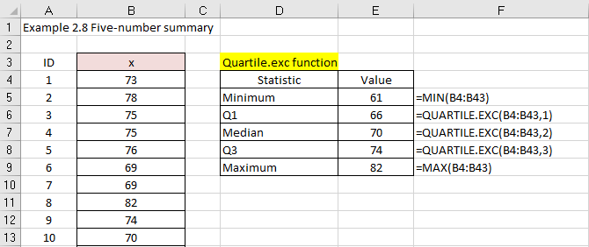
Excel solution

Slide 41
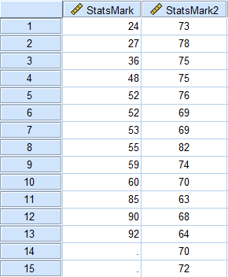
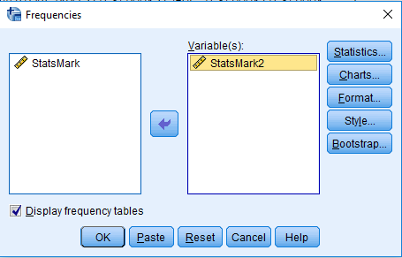
SPSS solution
The five number summary can be calculated using the SPSS Statistics Frequency command. Input data into SPSS (first 15 out of 25 values presented)
Select Analyze > Descriptives > Frequencies
Transfer StatsMark2 to the Variable(s) box

Slide 42
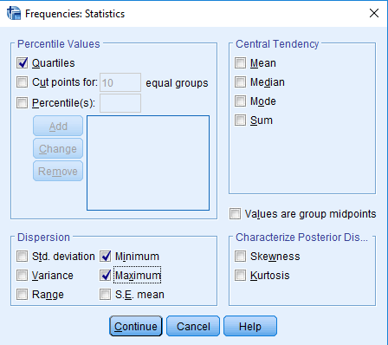
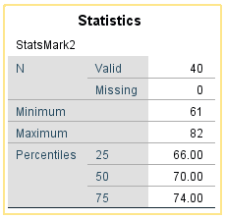
SPSS solution continued
Click on Statistics
Choose on Quartiles, Minimum, Maximum
Click on Add
SPSS output
Click Continue
Click OK

Slide 43
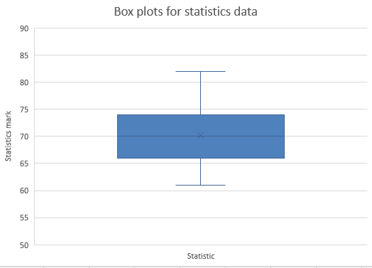
Box Plot
The box-and-whisker plot shows that the lowest 25% of the statistics marks are less spread out than the highest 25% of the distribution.
The plot also shows that the other half are approximately equally spread out.
This corresponds to the five-number-summary analysis in the previous section.
Excel solution – see textbook for instructions

Slide 44
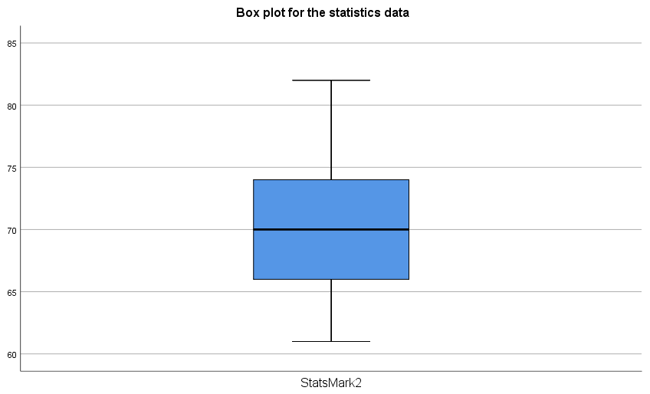
Box Plot continued
To identify symmetry
The box plot is interpreted as follows:
If the median within the box is not equidistant from the whiskers (or hinge), then the data is skewed. The box plot indicates right skewness because the distance between the median and the highest value is greater than the distance between the median and the lowest value. Furthermore, the top whisker (distance between Q3 and maximum) is longer than the lower whisker (distance between Q1 and minimum).
SPSS solution – see textbook for instructions

Slide 45
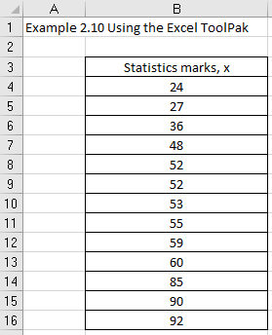
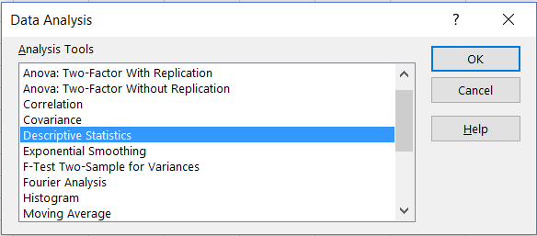
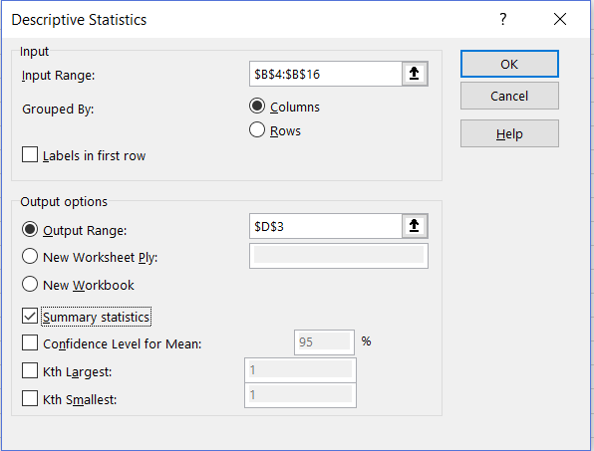
Excel Data Analysis
From the Data tab > Select Data Analysis
Select Descriptive Statistics
Input date range: B3:B16
Grouped By: Columns
Select Labels in first row
Output Range: D3
Click Summary statistics

Slide 46
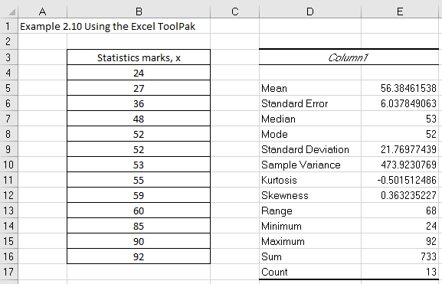
Excel Data Analysis continued

Slide 47
Conclusion
In this presentation we explored summarising data sets using the following three concepts:
Average
Dispersion
Shape
Remember that we would normally use the mean and standard deviation as the measure of central tendency and dispersion. If we have outliers in the data set then we could use the median/semi interquartile range as the measures of central tendency and dispersion.

